Slide 1
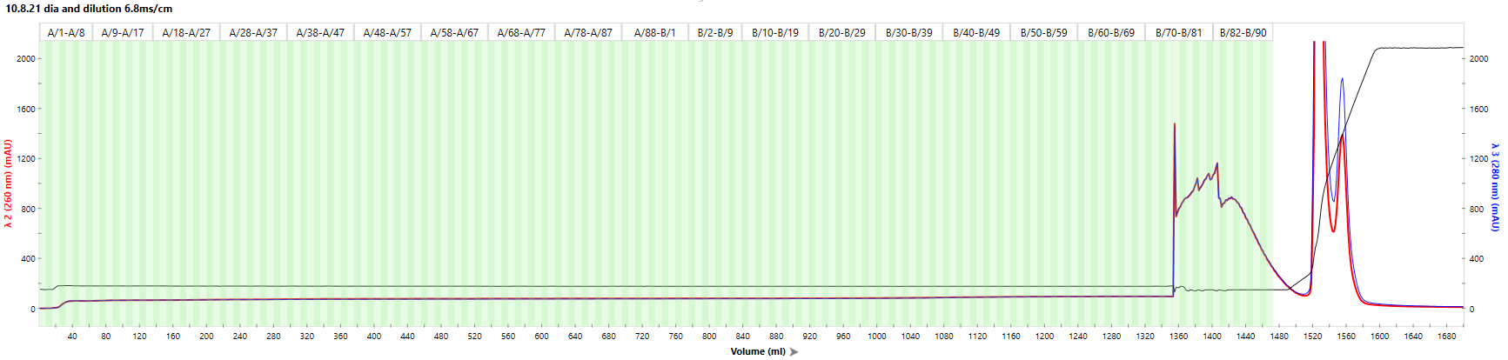
10.8.21 TFF trial : reg plasmids: hTERT-CMV, fibracel , 2.3x10⁸ cells, 2.5mg DNA, PEI;DNA ratio- 1;1
Clarification: Watersep 0.45uc 320.6 cm^2
Concentration and Diafiltration: TangenX cassettes, 100um, pes, 0. 1m^2
10.8.21 Purification steps (Q-XL)
1st Run
Flow-Through
Wash
Conductivity 7 mS/cm
Conductivity 5.6 mS/cm
Analysis:
qPCR
2D ddPCR
Western
Ruby

Slide 2
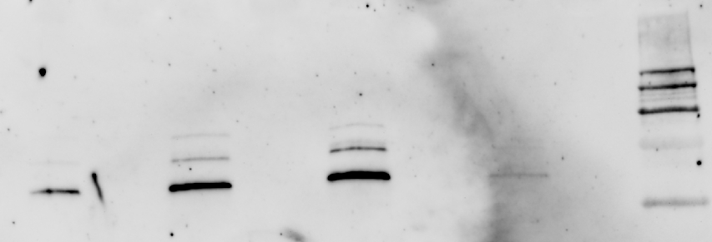
qPCR
2D ddPCR
Full capsids
FPLC-1
FPLC-2
FPLC-3
FPLC-4
Western blot
Conclusions:
TangenX cassette was hacked – probably due to long CIP
0.45um pore size is suitable for initial clarification
Sample that was diafiltrated w/o initial concentration kept the capsids intact – might need to consider lowering flow-rate for optimization
In purification step: decreased conductivity and prolonged wash step may improve recovery acc. To ddPCR results

Slide 3
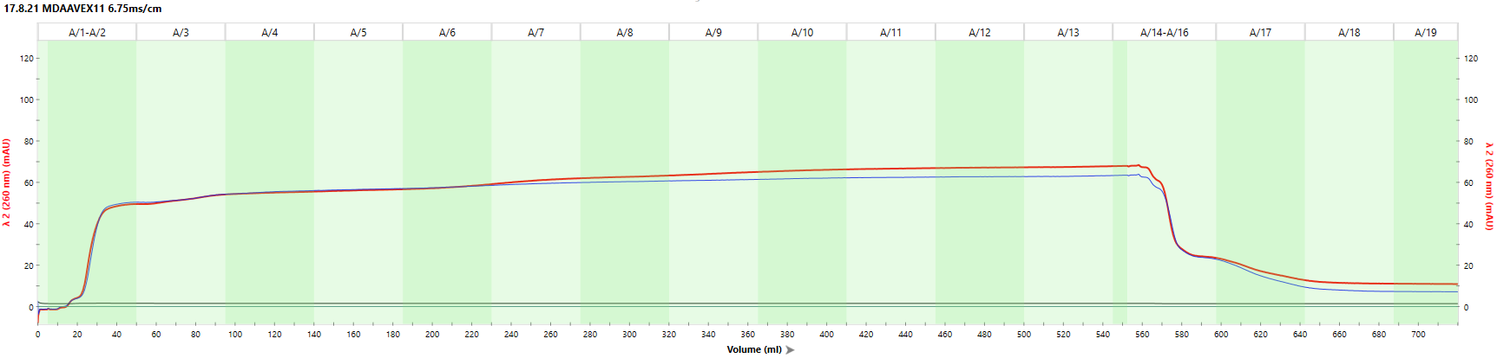
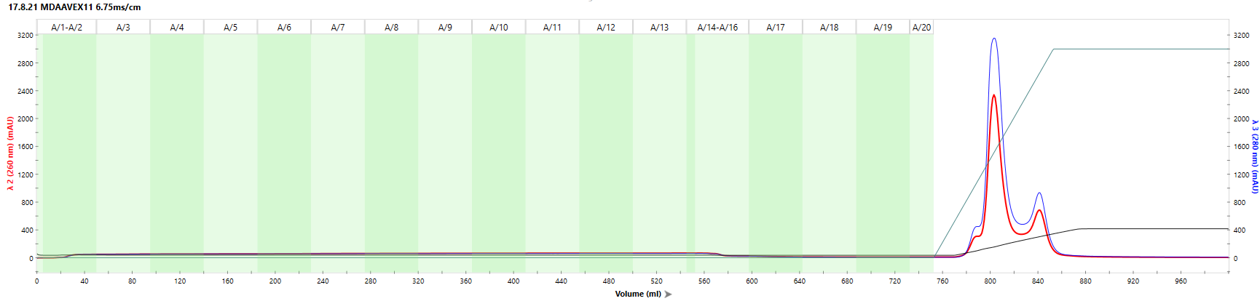
17.8.21 TFF trial : reg plasmids: hTERT-CMV, BioNoc , 3.2x10⁸ cells, 2.5mg DNA, PEI;DNA ratio- 1;1
Clarification: Watersep 0.45uc 320.6 cm^2
Diafiltration: TangenX cassettes, 100um, pes, 0. 1m^2
17.8.21 Purification steps (Q-XL)
Analysis:
qPCR
2D ddPCR

Slide 4
17.8.21 TFF trial : reg plasmids: hTERT-CMV, BioNoc , 3.2x10⁸ cells, 2.5mg DNA, PEI;DNA ratio- 1;1
qPCR
2D ddPCR
Full capsids
The quantification is not precise due to lack of sufficient dilutions.
Repeat was failed due to technical issues
Conclusions:
0.05um pore size is TOO small for initial clarification
Sample that was diafiltrated w/o initial concentration kept the capsids intact
Flow-rates through TangenX cassette were decreased and that lowered the efficiency of the diafiltration.
In purification step: 6.75mS/cm conductivity and prolonged wash did improve amplitude and recovery (qPCR)
ddPCR results needs to be repeated (needed further dilutions for accuracy)

